Slide 1
Group 2 Level Designs
Elliot Page
Max Carter
Rebecca Brannum

Slide 2
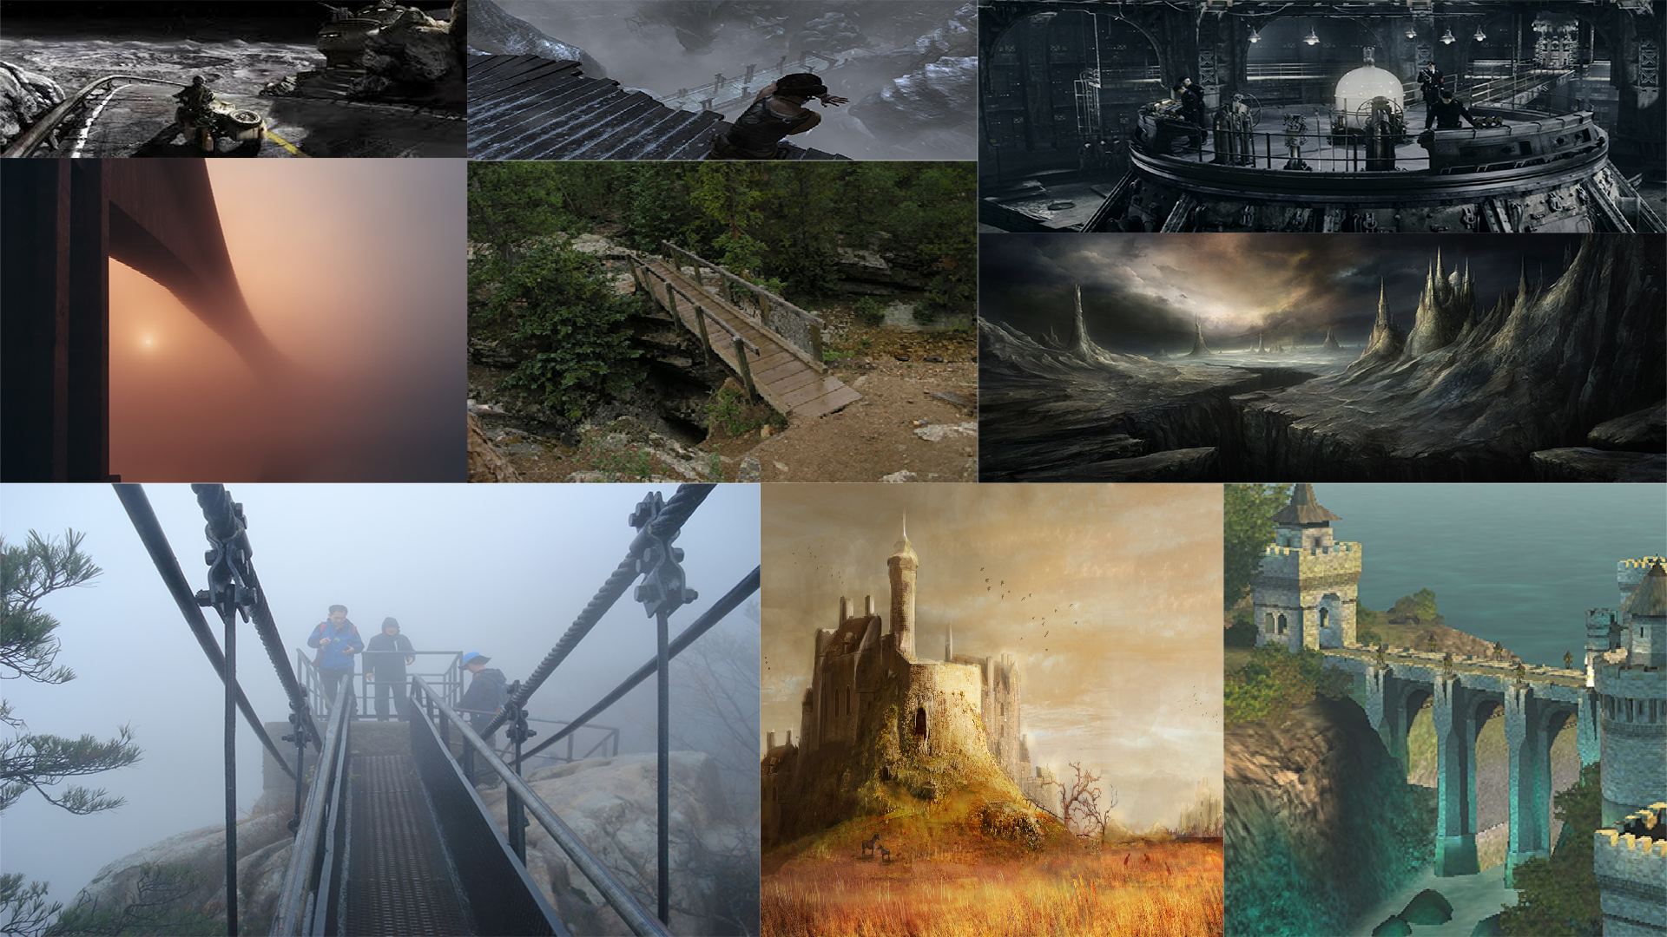
Level 1 Style guide

Slide 3
Level 1 Asset List
Metallic walls (grey)
Bridge chain
Boulders
Awnings/balconies
Weapons from UT4
Gravel texture
Zipline
Wasteland skybox

Slide 4
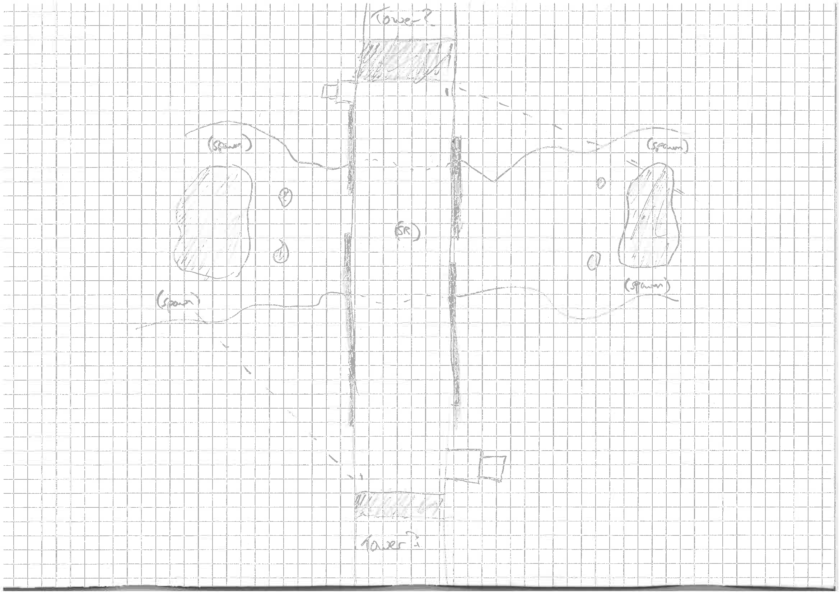
Level 1 Floor Plan

Slide 5
Level 2 Style Guide

Slide 6
Level 2 Asset List
Metal panels (silver)
Space skybox
Solid metallic flooring
Command console/computers
Pickups from UT4
Lifts
Air ducts
Floating platforms
Teleporters

Slide 7
Level 2 Floor Plan

Slide 8
Level 3 Style Guide

Slide 9
Level 3 Asset List

Slide 10
Level 3 Models
https://sketchfab.com/models/2cbda2361fc94f87a62b80f00b896d3d

Slide 11
Research and References

